Slide 1
Super Capacitor in Drone Application
Advisor: Dr. Javier Kypuros
Presented By:
Jonathan Dy Rosales
Mark Ortiz
Ricardo Castrellon
Jose Araujo

Slide 2
What is a Polycopter?

Slide 3
The Problem
Battery Charge Time
Flight Time
Durability
Regulation

Slide 4
Goals/Objectives
Goals
Reduce Charge Time
Increase Flight Time (30min – 60min)
Affordable

Slide 5
Needs/Wants
Needs:
Durable
Affordable
Lightweight
Payload
Long Flight Time
Short Recharge
Wants:
Aesthetically appeasing
Quick Respond time to control module

Slide 6
Market Research

Slide 7
Market Holder

Slide 8
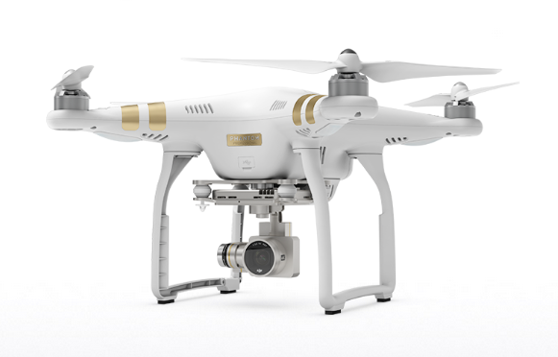
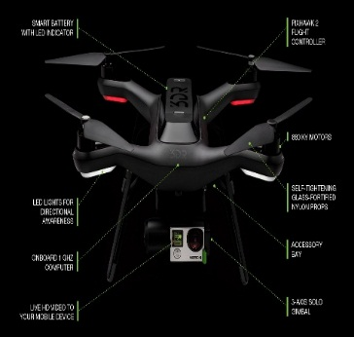
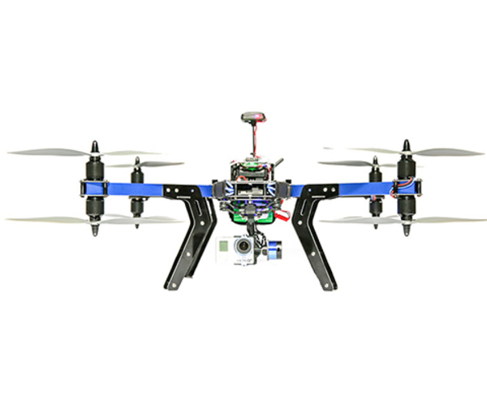
Product | Location | Website | Product Info | Contact Info
 | Shenzhen, China Los Angeles, CA, USA | www.dji.com | Phantom 3 Professional Cost: $1259 USD Weight: 1280 g Flight Time: 20 min Pay Load: 2429 g | DJI North America Tel: +1(818)235-0789 Email: us.support@dji.com
 | United States Several Retailers Best Buy Drone Plus | www.3drobotics.com | Solo Smart Drone Cost: $ 999 USD Weight: 500 g Flight Time: 20 min Pay Load: 420 g | 3D Robotics Tel: 1(855)982-2898 Email: help@3dr.com
 | United States Several Retailers Best Buy Drone Plus | www.3drobotics.com | X8+ Cost: $1350 USD Weight: 2560 g Flight Time: 15 min Pay Load: 800 g | 3D Robotics Tel: 1(855)982-2898 Email: help@3dr.com

Slide 9
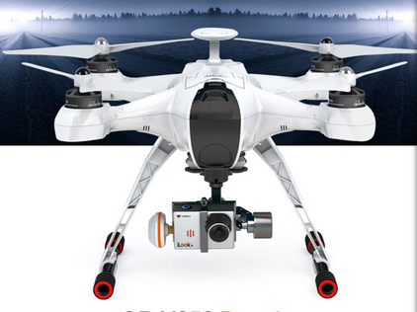
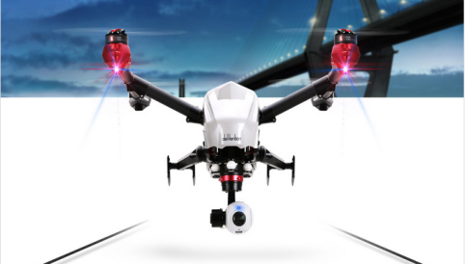
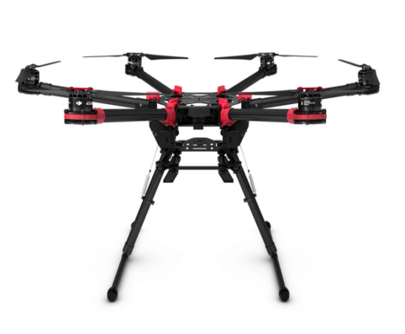
Product | Location | Website | Product Info | Contact Info
 | Guangzhou, China | www.walkera.com | QR X900 Premium Cost: $1099 USD Weight: 1280 g Flight Time: 25 min Pay Load: 2429 g | Walkera Tel: 86-020-84915116 Email: info@walkera.com
 | Guangzhou, China | www.walkera.com | Voyager 3 Cost: $1999 USD Weight: 3650 g Flight Time: 20 min Pay Load: None | Walkera Tel: 86-020-84915116 Email: info@walkera.com
 | Washington DC. Houston, TX | www.expertdrones.com | Spreading Wings S900 Cost: $1400 USD Weight: 3300 g Flight Time: 18 min Pay Load: 5300 g | Expert Drones Tel: 202-657-1989 DC Tel: 832-4995049 TX Email: houston@expertdrones.com

Slide 10
Features | Phantom 3 Professional | Solo Smart Drone | X8+
Price | Cost: $1259 USD | $999 USD | $1350 USD
Weight | 1280 g | 500 g | 2560 g
Flight Time | 25 min | 20 min | 15 min
Battery | LIPo 4S 15.2V 4480 mAh | Lipo 14.8 V 5200 mAh | LiPo 4S 14.8 V 10,000mAh
Motors | 960 kV | 880 kV | 800 kV
Maximum Payload Capacity | 2029 g | 420 g | 800 g
Charge Time | 1-1.5 hrs | 1.5 hrs | 2 hrs
Dimensions | 590 mm (diagonal size) | 460 mm (diagonal size) | 35x51x20 (LxWxH)
Company | DJI Innovations | 3D Robotics | 3D Robotics

Slide 11
Features | QR X350 Premium | Voyager 3 | Spreading Wings S900
Price | $1099 USD | $1999 USD | $1400 USD
Weight | 1280 g | 3650 g | 3300 g
Flight Time | 25 min | 20 min | 18 min
Battery | LiPo 29.6 V 3000 mAh | LiPo (2) 29.6 V 3000 mAh | LiPo 6S 15.2 V 4000mAh
Motors | - | - | 400 kV
Maximum Payload Capacity | 2429 g | None | 5300 g
Charge Time | 1.5 hrs | 2-2.5 hrs | 2 hrs
Dimensions | 233 mm (diagonal size) | 346 mm (diagonal size) | 900 mm (diagonal size)
Company | Walkera | Walkera | Expert Drones

Slide 12
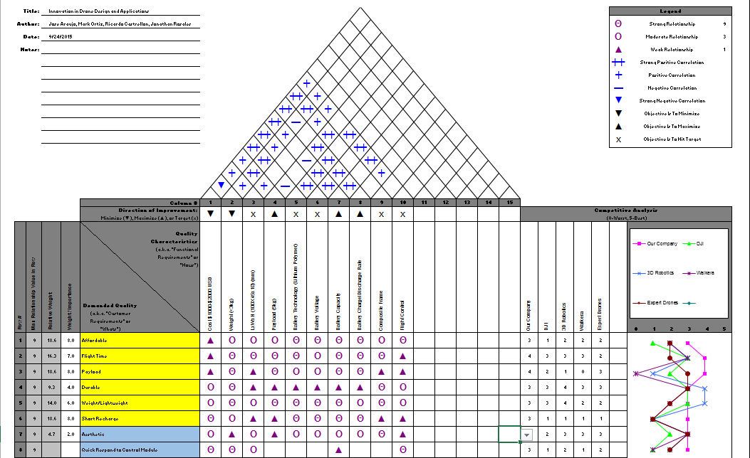

Slide 13
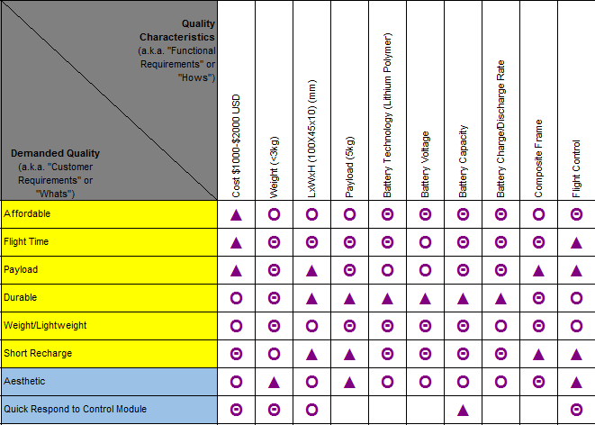

Slide 14
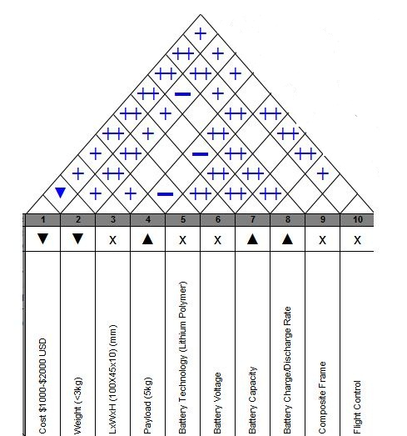

Slide 15
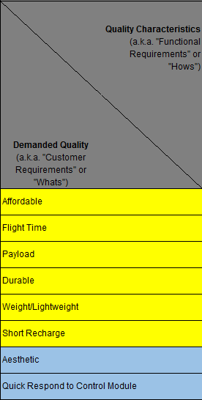
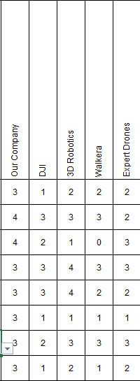

Slide 17
Timeline

Slide 18
Proposed Solutions
Composite Frame
Efficient Motors
Improved Flight Controller
Improved Duct/Propeller Design
Super Capacitor Battery.

